Slide 1
CSCE 5520
Wireless Networks and Protocols
Cellular: 1G and 2G
1
Peter A. Steenkiste, CMU

Slide 2
Overview
Cellular principles – “classic” view
» A bit of history
» Cellular design
» How does a mobile phone call take place?
» Handoff
» Frequency Allocation, Traffic Engineering
Early cellular generations: 1G, 2G, 3G
Today’s cellular: 4G – LTE
Emerging: 5G widely advertised
Some slides based on material from
“Wireless Communication Networks and Systems”
© 2016 Pearson Higher Education, Inc.
2

Slide 3
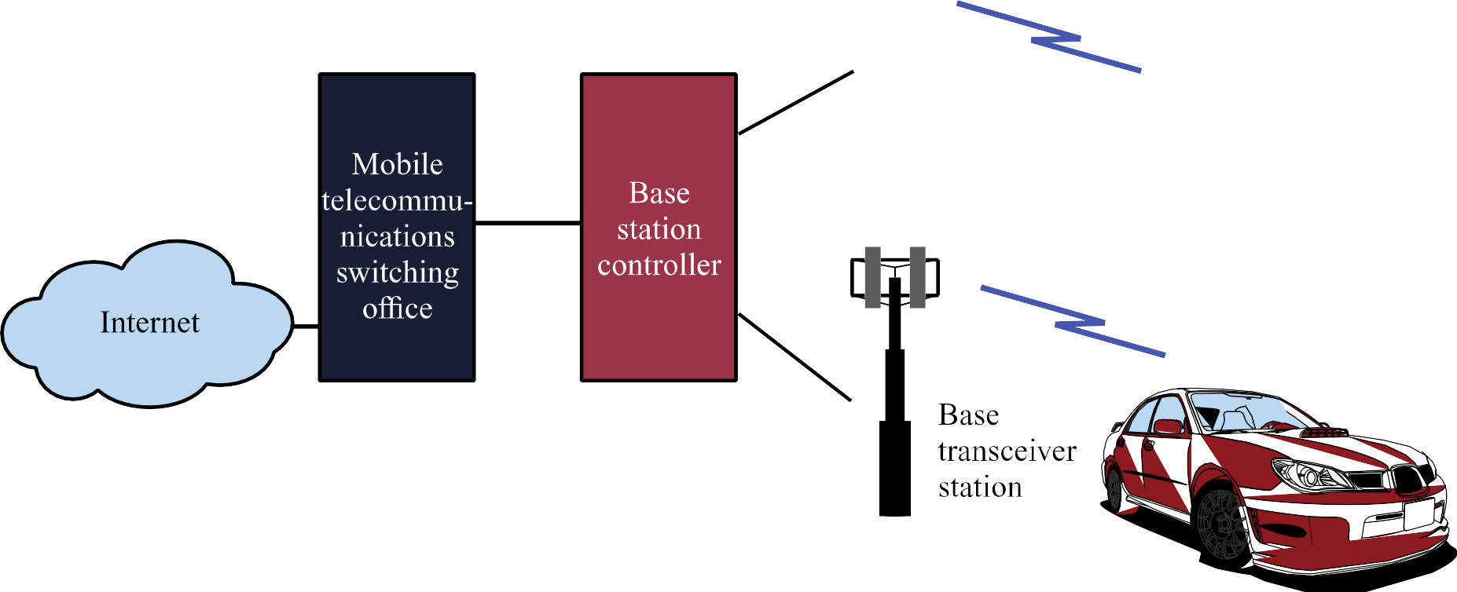
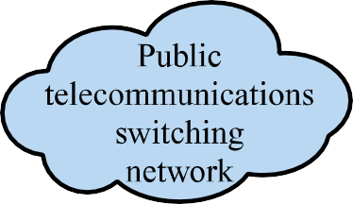

Overview of Cellular System
3

Slide 4
Elements of a cellular system
Base Station (BS): includes antenna, a controller, and a number of transceivers for communicating on the channels assigned to that cell
Controller handles the call process between the mobile unit and the rest of the network
MTSO: Mobile Telecommunications Switching Office, serving multiple BSs. Connects calls between mobiles and to the PSTN. Assigns the voice channel, performs handoffs, billing
4

Slide 5
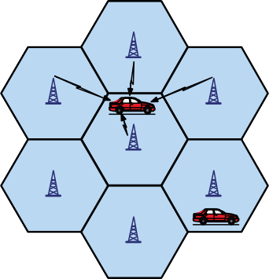
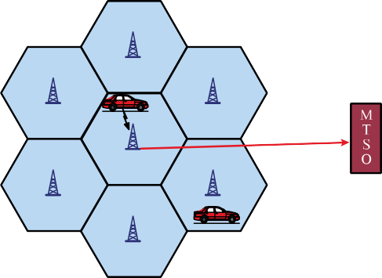
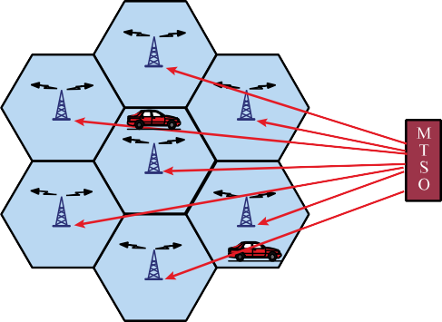
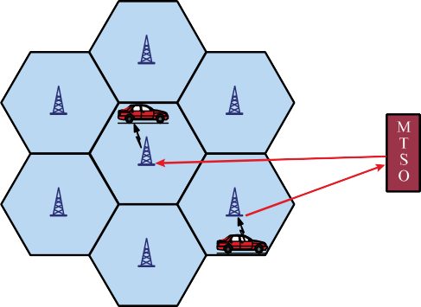
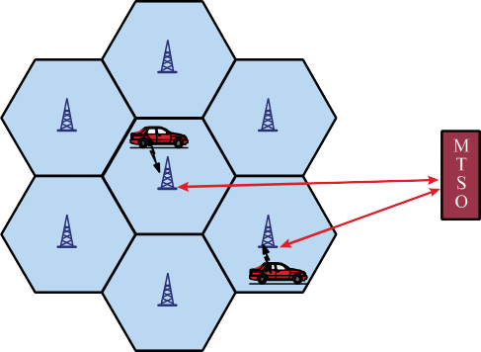
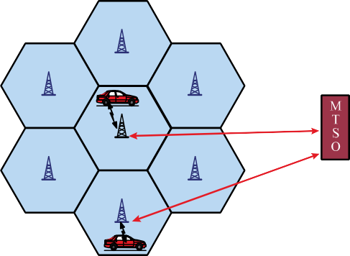
MTSO Sets up Call between Mobile Users
Mobile unit initialization
Mobile-originated call
Paging
Call accepted
Ongoing call
Handoff
5

Slide 6
Paging
Broadcast mechanism to locate a target mobile unit
Normally, there is knowledge on a limited number of cells where the mobile may be (Location Area in GSM, Routing Area if data packet sessions)
GSM: neighbor cells grouped in Location Area and subscriber only updates when moving across. Paging restricted to the Location Area itself.
» How do we assign cells to LAs?
6

Slide 7
Handoff Strategies Used to Determine Instant of Handoff
Metrics related to handoff:
» Call blocking probability: probability of a new call being blocked
» Call dropping probability: probability that a call is terminated due to a handoff
Possible strategies for scheduling handoffs:
» Relative signal strength – L₁
» Relative signal strength with threshold Th₂ – L₂
» Relative signal strength with hysteresis H – L₃
» Relative signal strength with hysteresis and threshold Th₁ or Th₂ – L₃; Th₃ – L₄
» Prediction techniques
7

Slide 8
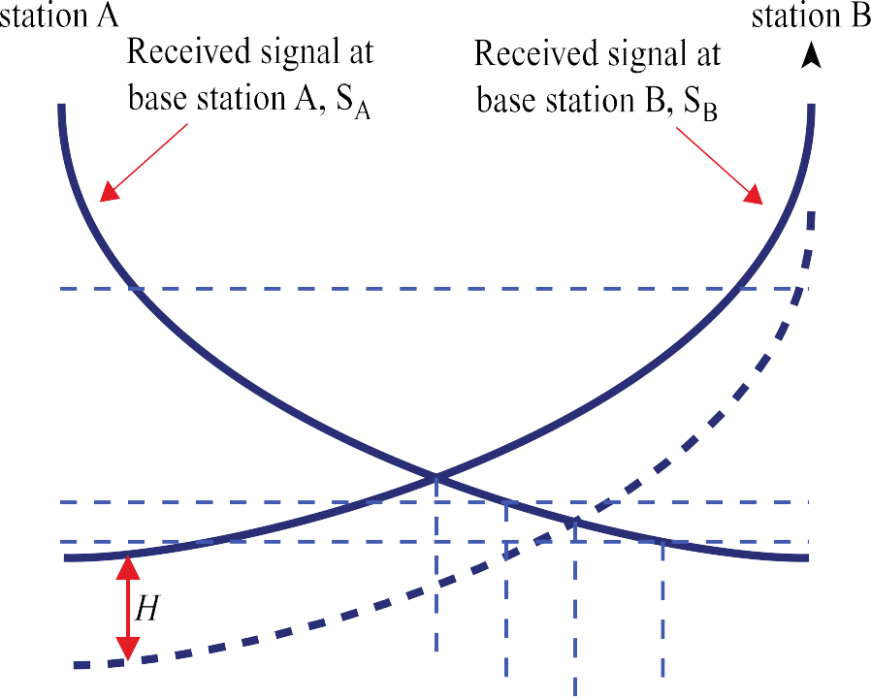










Example of Handoff
8

Slide 9
Mobile Radio Propagation Effects
Signal strength
» Must be strong enough to maintain signal quality at the receiver
» Must not be so strong as to create too much co-channel interference with channels in another cell using the same frequency band
» Fading may distort the signal and cause errors
Mobile transmission power minimized to avoid co-channel interference, alleviate health concerns and save battery power
In systems using CDMA, need to equalize power from all mobiles at the BS
9

Slide 10
Open and Closed Loop Power Control
Open loop power control: BS sends pilot
» Used by mobile to acquire timing and phase reference, and to assess channel attenuation
» Mobile adjust power accordingly
– Assume up and down channels are similar
» Can adjust quickly but not very accurate
Closed loop power control: power is adjust based on explicit feedback from receiver
» Reverse signal power level, received signal-to-noise ratio, or received bit error rate
» Mobile to BS: BS base station sends power adjustment command to mobile based on observed signal
» BS to mobile: BS adjust power based on information provided by mobile

Slide 11
Fixed Channel Assignment (FCA)
Each cell is allocated a predetermined set of voice channels.
Any call attempt within the cell can only be served by the unused channels in that cell
If all the channels in that cell are being used the call is blocked  user does not get service
A variation of FCA: the cell whose channels are all being used is allowed to borrow channels from the next cell. MTSO supervises this operation.

Slide 12
Dynamic Channel Assignment (DCA)
Channels are not permanently assigned to cells. Instead, for each request the BS requests a channel from the MTSO.
MTSO allocates a channel using an algorithm that takes many factors into account
» The likelihood of future blocking within the cell, the frequency of use of the candidate channel, the reuse distance of the channel, and other cost functions.
» MTSO only allocates a channel if it is not being used in the restricted distance for co-channel interference
DCA can use channels more effectively but incurs measurement, communication, and computer overhead

Slide 13
Overview
Cellular principles – “classic” view
Early cellular generations: 1G, 2G, 3G
» 1G: AMPS
» 2G: GSM
» 2.5G: EDGE, CDMA
» 3G: WCDMA
Today’s cellular: 4G – LTE
Emerging: 5G widely advertised
Some slides based on material from
“Wireless Communication Networks and Systems”
© 2016 Pearson Higher Education, Inc.
13
Peter A. Steenkiste, CMU

Slide 14
Outline
1G: AMPS
2G: GSM
2.5G: EDGE, CDMA
3G: WCDMA
Some slides based on material from
“Wireless Communication Networks and Systems”
© 2016 Pearson Higher Education, Inc.

Slide 15
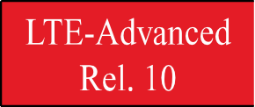
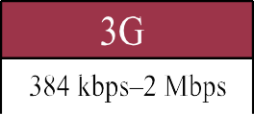
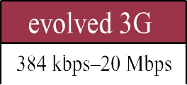
Evolution of Cellular Wireless Systems

Slide 16
Advanced Mobile Phone Service (AMPS)
In North America, two 25-MHz bands were allocated (DL: 869-894 MHz, UP: 824-849 MHz)
» Deployed since early 80’s by two providers
Channels are spaced by 30 KHz, allowing for 416 channels (21 control, 395 for voice calls)
» Control channels are full duplex data channels at 10 Kbps
» Includes preamble, word sync, and Digital Color Code identifying the base station
» Can send urgent control in data channels
Voice calls carried in analog using frequency modulation
» Effectively extends analog telephone over wireless
Cell size = 2-20Km, frequency reuse is exploited

Slide 17
AMPS Operation
When unit wakes up, it sends telephone and serial number to the Mobile Telephone Switching Office (MTSO) over control channel
» Both stored in read-only memory
» Used for billing purposes and to detect stolen phones
Steps in placing a call:
User dials in a number – sent to the MTSO
MTSO verifies validity of service request
MTSO notifies user of channels to use for up/down link
MTSO sends ring signal to the called party
MTSO completes circuit when party picks up
When either party hangs up, MTSO releases circuit and wireless channels, and completes billing

Slide 18
Evolution of Cellular Wireless Systems

Slide 19
Differences Between First and Second Generation Systems
Digital traffic channels – first-generation systems are almost purely analog; second- generation systems are digital
» Using FDMA/TDMA or CDMA
Encryption: second generation systems use encryption to prevent eavesdropping
Error detection and correction: digital encoding allows for error detection and correction, giving clear voice reception
Channel access – channels can be dynamically shared by a number of users
» i.e., multiplexing in time and frequency

Slide 20
Motivation for Switch from Analog to Digital
Higher quality
Compression
Encryption
Error Detection and Correction
Multiplexing channels by different users
» i.e. TDMA

Slide 21
Global System for Mobile (GSM) - Background
GSM is a set of ETSI standards specifying the infrastructure for a digital cellular service
» European Telecommunications Standards Institute
» Developed to provide a common second-generation technology for Europe
The standard was used in approx. 109 countries around the world including Europe, Japan and Australia
Order 44 million subscribers
Process: define a set of requirements, and then develop technologies to meet them

Slide 22
Design Requirements for GSM-like 2G Systems
Degree of multiplexing: at least 8
» Not worth adding TDMA complexity otherwise
Maximum cell radius: ~35km
» Needed for rural areas
Frequency: around 900 MHz
Maximum speed: 250 km/hr – high-speed train
Maximum coding delay: 20 msec
» Do not want to add too much to network delay (voice!)
Maximum delay spread: ~10 msec
Bandwidth: up to 200 KHz, ~25 kHz/channel

Slide 23
GSM Features
Hybrid FDMA/TDMA approach
Mobile station communicates across the air interface with base station in the same cell as mobile unit
Mobile equipment (ME) – physical terminal, such as a telephone or PCS
» ME includes radio transceiver, digital signal processors and subscriber identity module (SIM)
GSM subscriber units are generic until a SIM is inserted
» SIMs roam since they are based on single standard
» Not necessarily the case for subscriber devices – may use different versions of the protocol

Slide 24
GSM SIM
Users have a Subscriber Identity Module (SIM) – a smart card
The user identity is associated with a mobile device through the SIM card
The SIM is portable and transferable
All cryptographic algorithms (for authentication and data encryption) can be realized in the SIM
May also store short messages, charging info, ..
SIM implications:
» Equipment mobility and user mobility are not the same
» International roaming independent of the equipment and network technology

Slide 25
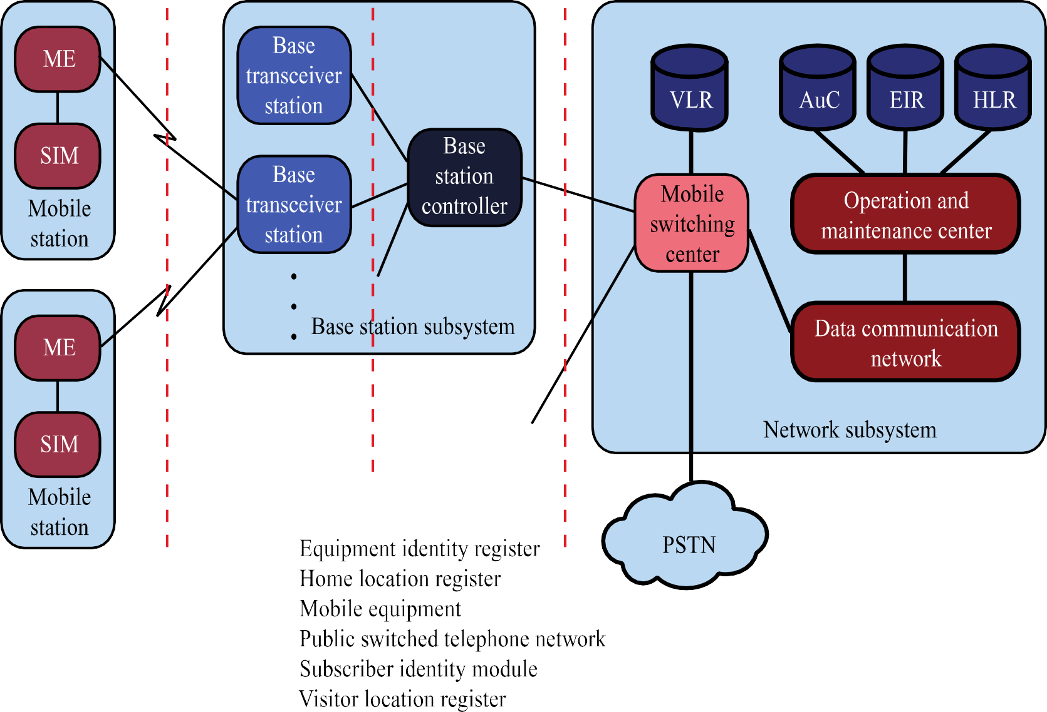
Global GSM System

Slide 26
Base Station Subsystem (BSS)
BSS consists of base station controller (BSC) and one or more base transceiver stations (BTS)
BSC reserves radio frequencies, manages handoff of mobile unit from one cell to another within the BSS, and controls paging
Each BTS defines a single cell
» Includes radio antenna, radio transceiver and a link to a base station controller (BSC)

Slide 27
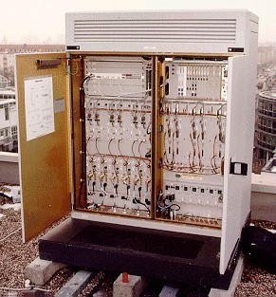
Base Transceiver Station
Radio transmission/reception management (modulation/demodulation, equalisation, interleaving ...)
Physical layer management (TDMA transmission, SFH, coding, ciphering ...)
Link layer management
Received signal quality and power measurement

Slide 28
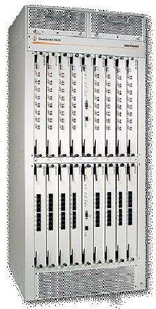
Base Station Controller
Interface between MSC and BTSs
Forwarding of traffic
Coordination of and with BTSs
Radio resource management for the Base Station Subsystem
Channel allocation
BTS measures processing
BTS and MS power control
Handover
...

Slide 29
Global GSM System

Slide 30
Network Subsystem (NS)
NS provides link between cellular network and public switched telecommunications networks (PSTN)
» Controls handoffs between cells in different Base Station Subsystems
» Authenticates users and validates accounts
» Enables worldwide roaming of mobile users
Central element of NS is the Mobile Switching Center (MSC)

Slide 31
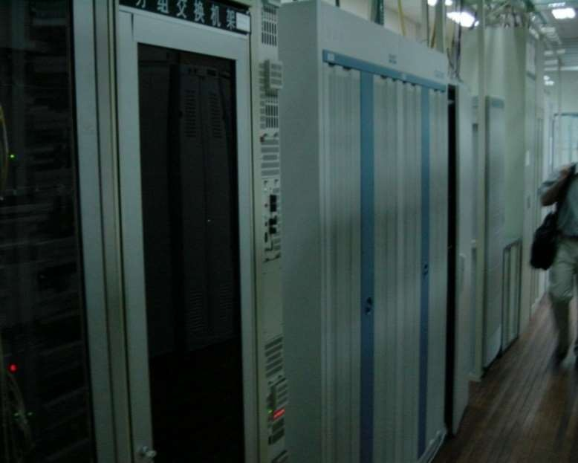
Mobile Switching Center
Management of the communication between mobiles and the fixed network
The Gateway Mobile Switching Controller forms the gateway for calls to and from external networks
MSC is also responsible for mobility management
Handover between Base Station Subsystems
Roaming across networks

Slide 32
Handover
Executed by BSC (channels) and by MSC (routing)
Initiated by base station:
» BS monitors the signal coming from the MT
» Low signal => Need to do handover
Mobile-terminal aided:
» BS transmit beacon
» MT, hearing better beacon, request join
– Sends the identity of the old BS to the new BS
» BS accepts the MT, calls are then forwarded
Inter-system system handover is managed MSC
» With extra connections to the HLR/VLR

Slide 33
Mobile Switching Center (MSC) Databases
Home location register (HLR) database – stores information about each subscriber that belongs to this MSC
Visitor location register (VLR) database – maintains information about subscribers currently physically in the region
Authentication center database (AuC) – used for authentication activities, holds encryption keys
Equipment identity register database (EIR) – keeps track of the type of equipment that exists at the mobile station

Slide 34
Roaming In Cellular
Subscribers are associated with a particular network subsystem, e.g, Pittsburgh region
» Historically, phone number is associated with this system
How can you receive a phone call if you are not in your?
» Does this sound familiar?
Roaming falls into two categories
» Roaming between systems but in the network of the same provider
» Roaming across providers, e.g., when traveling abroad
» Roaming mechanisms are similar but business aspects and some details are different

Slide 35
Home Location Register
One per Network Subsystem
» Basically a local operator
Contains entries for every subscriber and every mobile ISDN number that is homed in the respective network
Permanent subscriber data and relevant temporary information
Current location of the mobile station
All administrative activities of the subscriber happen here!

Slide 36
Visitor Location Register
Typically one per MSC, but 1 VLR could be responsible for more than 1 MSC
Stores data on all mobile stations which are currently in the administrative area of the respective MSC
A roaming MS may be registered in a VLR of its home network or the foreign network depending on its location
MS registers upon entering a LA. The MSC passes the identity of the MS and LAI to VLR
» See next slide

Slide 37
GSM Addressing Hierarchy
Device
» IMEI (International Mobile Equipment Identifier)
User
» IMSI (International Mobile Subscriber Identifier)
» MSISDN (Mobile Subscriber IDSN Number)
– “Real phone number”
» MSRN (Mobile Station Roaming Number)
» TMSI (Temporary Mobile Subscriber Identity)
» LMSI (Local Mobile Subscriber Identity)
Other
» LAI (Location Area Identity)
» CI (Cell Identity)

Slide 38

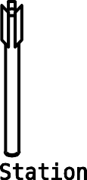


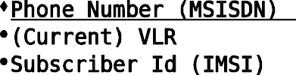





GSM Address Lookup (“registers”)
~Home Agent
~Foreign Agent
Address in hosting network
Hard state: Current MSC/VLR, LAI
» (Necessary to page phone, updated whenever mobile moves)
Soft-ish state:
» MSRN, cell ID, TMSI
Note: Grossly simplified for your safety and sanity!

Slide 39
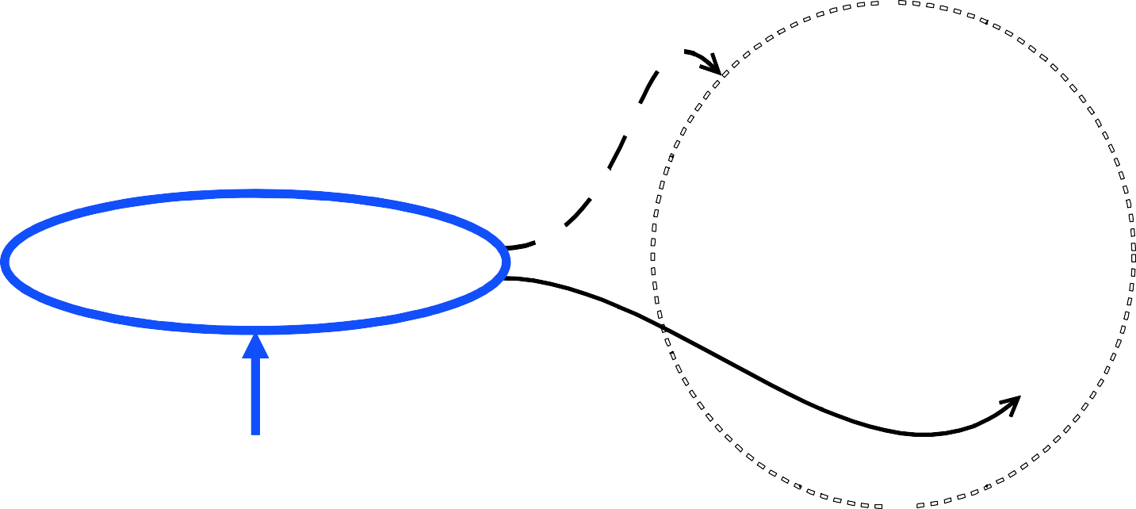






Comparison with Mobile IP
~Home Agent
~Foreign Agent
Addressing information in hosting network

Slide 40
Roaming Discussion
Roaming introduces some challenges for the phone, similar to those for Wifi
When you open your phone, how do you know whether the cellular channels are?
» There is a lot of variability across countries
When you are outside of the coverage area of your provider, how do you know which providers you can use?
Your phone needs to have this information in its memory (at least enough to get started)
» Updated by your provider as part of regular updates

